Slide 1


UML-2020-01-30
CTI One Corporation
Version: 1.0
Date: Jan 30, 2020, updated: Xueli Yang

Slide 2

UML
What is the UML;
Why we need UML;
Example;
Download link:
http://www.umldesigner.org/download/

Slide 3
What is the UML
UML, standard for Unified Modeling Language. It is a standardized modeling language consisting of a complete set of diagrams. UML is an important part of developing object-oriented software. UML mainly uses graphical symbols to represent the design of a software project, and using UML can help project teams communicate, explore potential designs, and validate the architectural design of the software.

Slide 4
Why We Need UML
Writing software is like building a house. The more complex the system is, the more important the communication between the engineers who are involved in the project. UML is applied to the solution of object-oriented problems. UML provides a common language for software design among analysts, designers, and programmers. The fundamental principles of object-oriented problem-solving -- starting with building models.

Slide 5
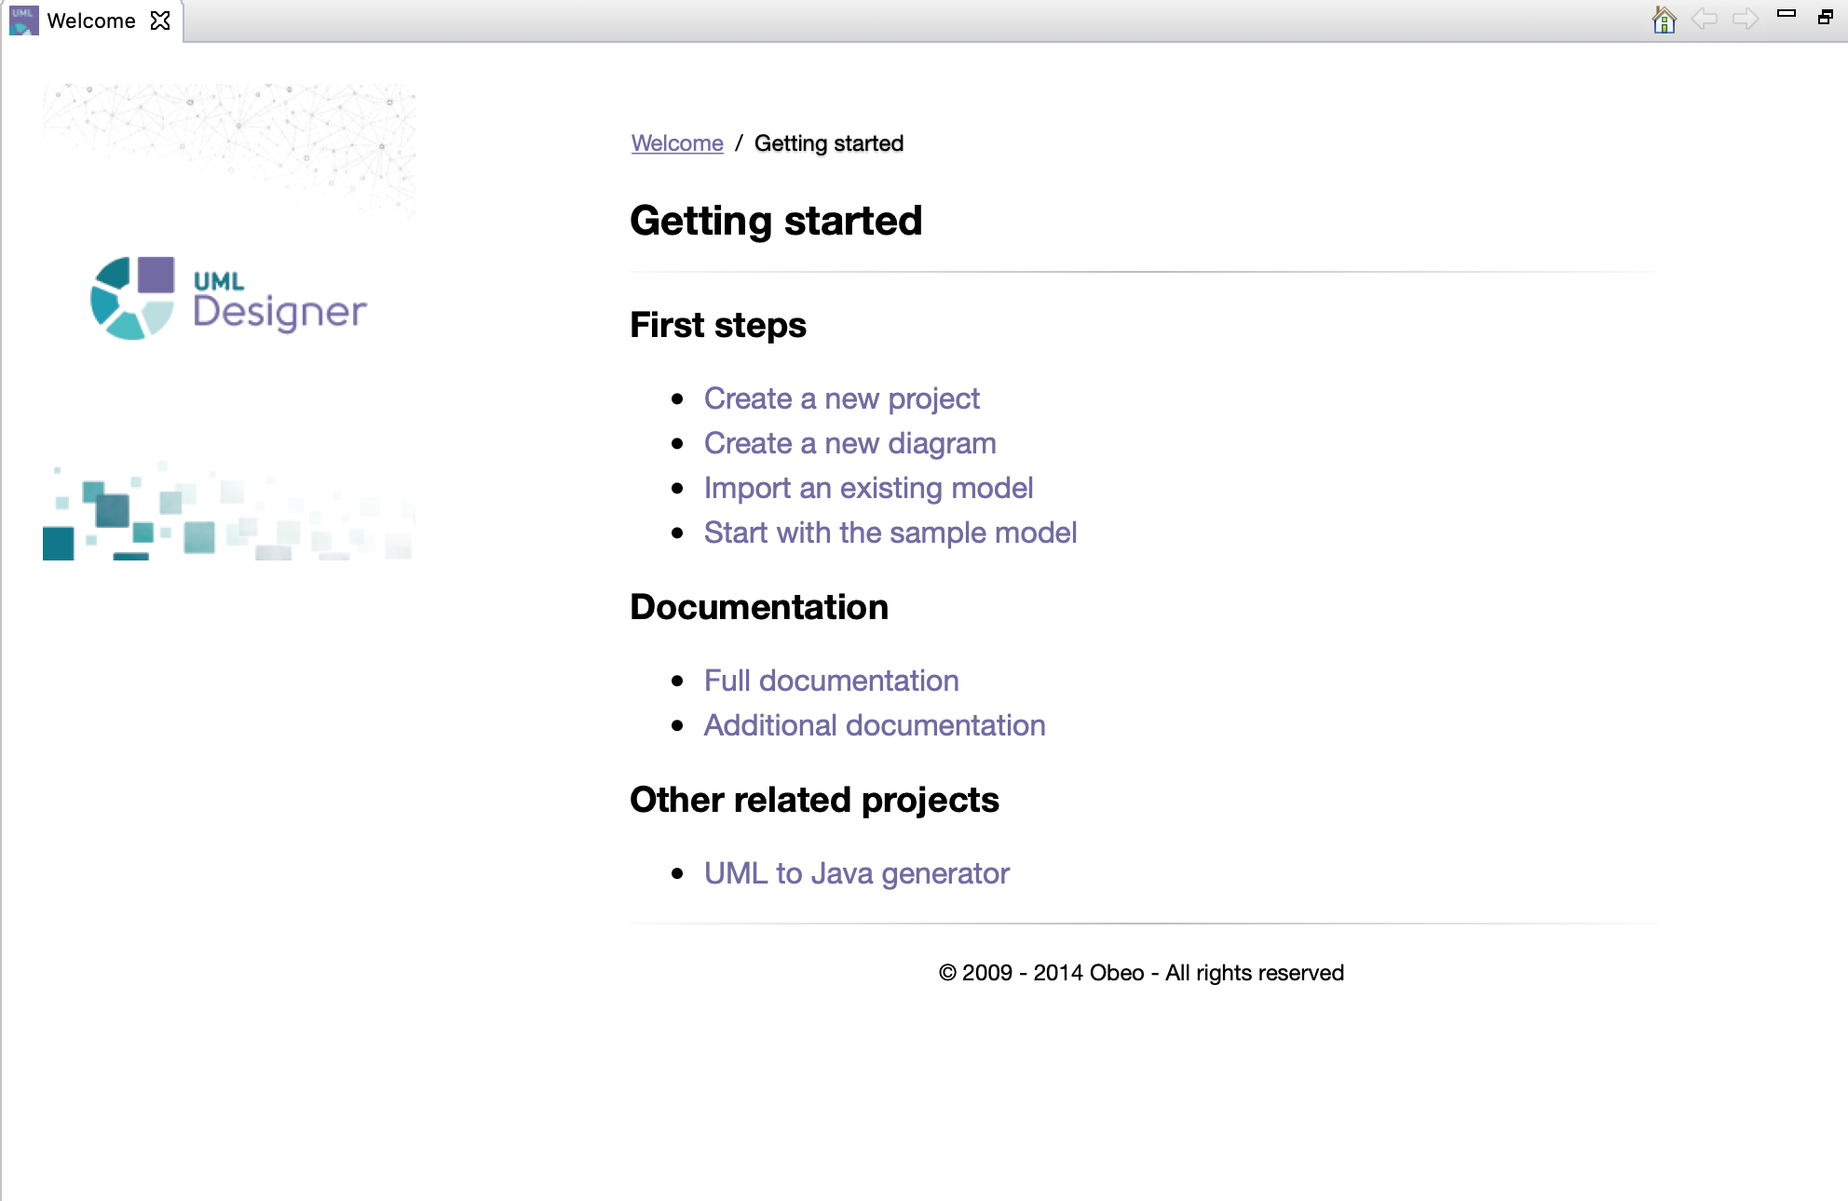
Example
Software Name: UML Designer
http://www.umldesigner.org/download/
It is free!

Slide 6
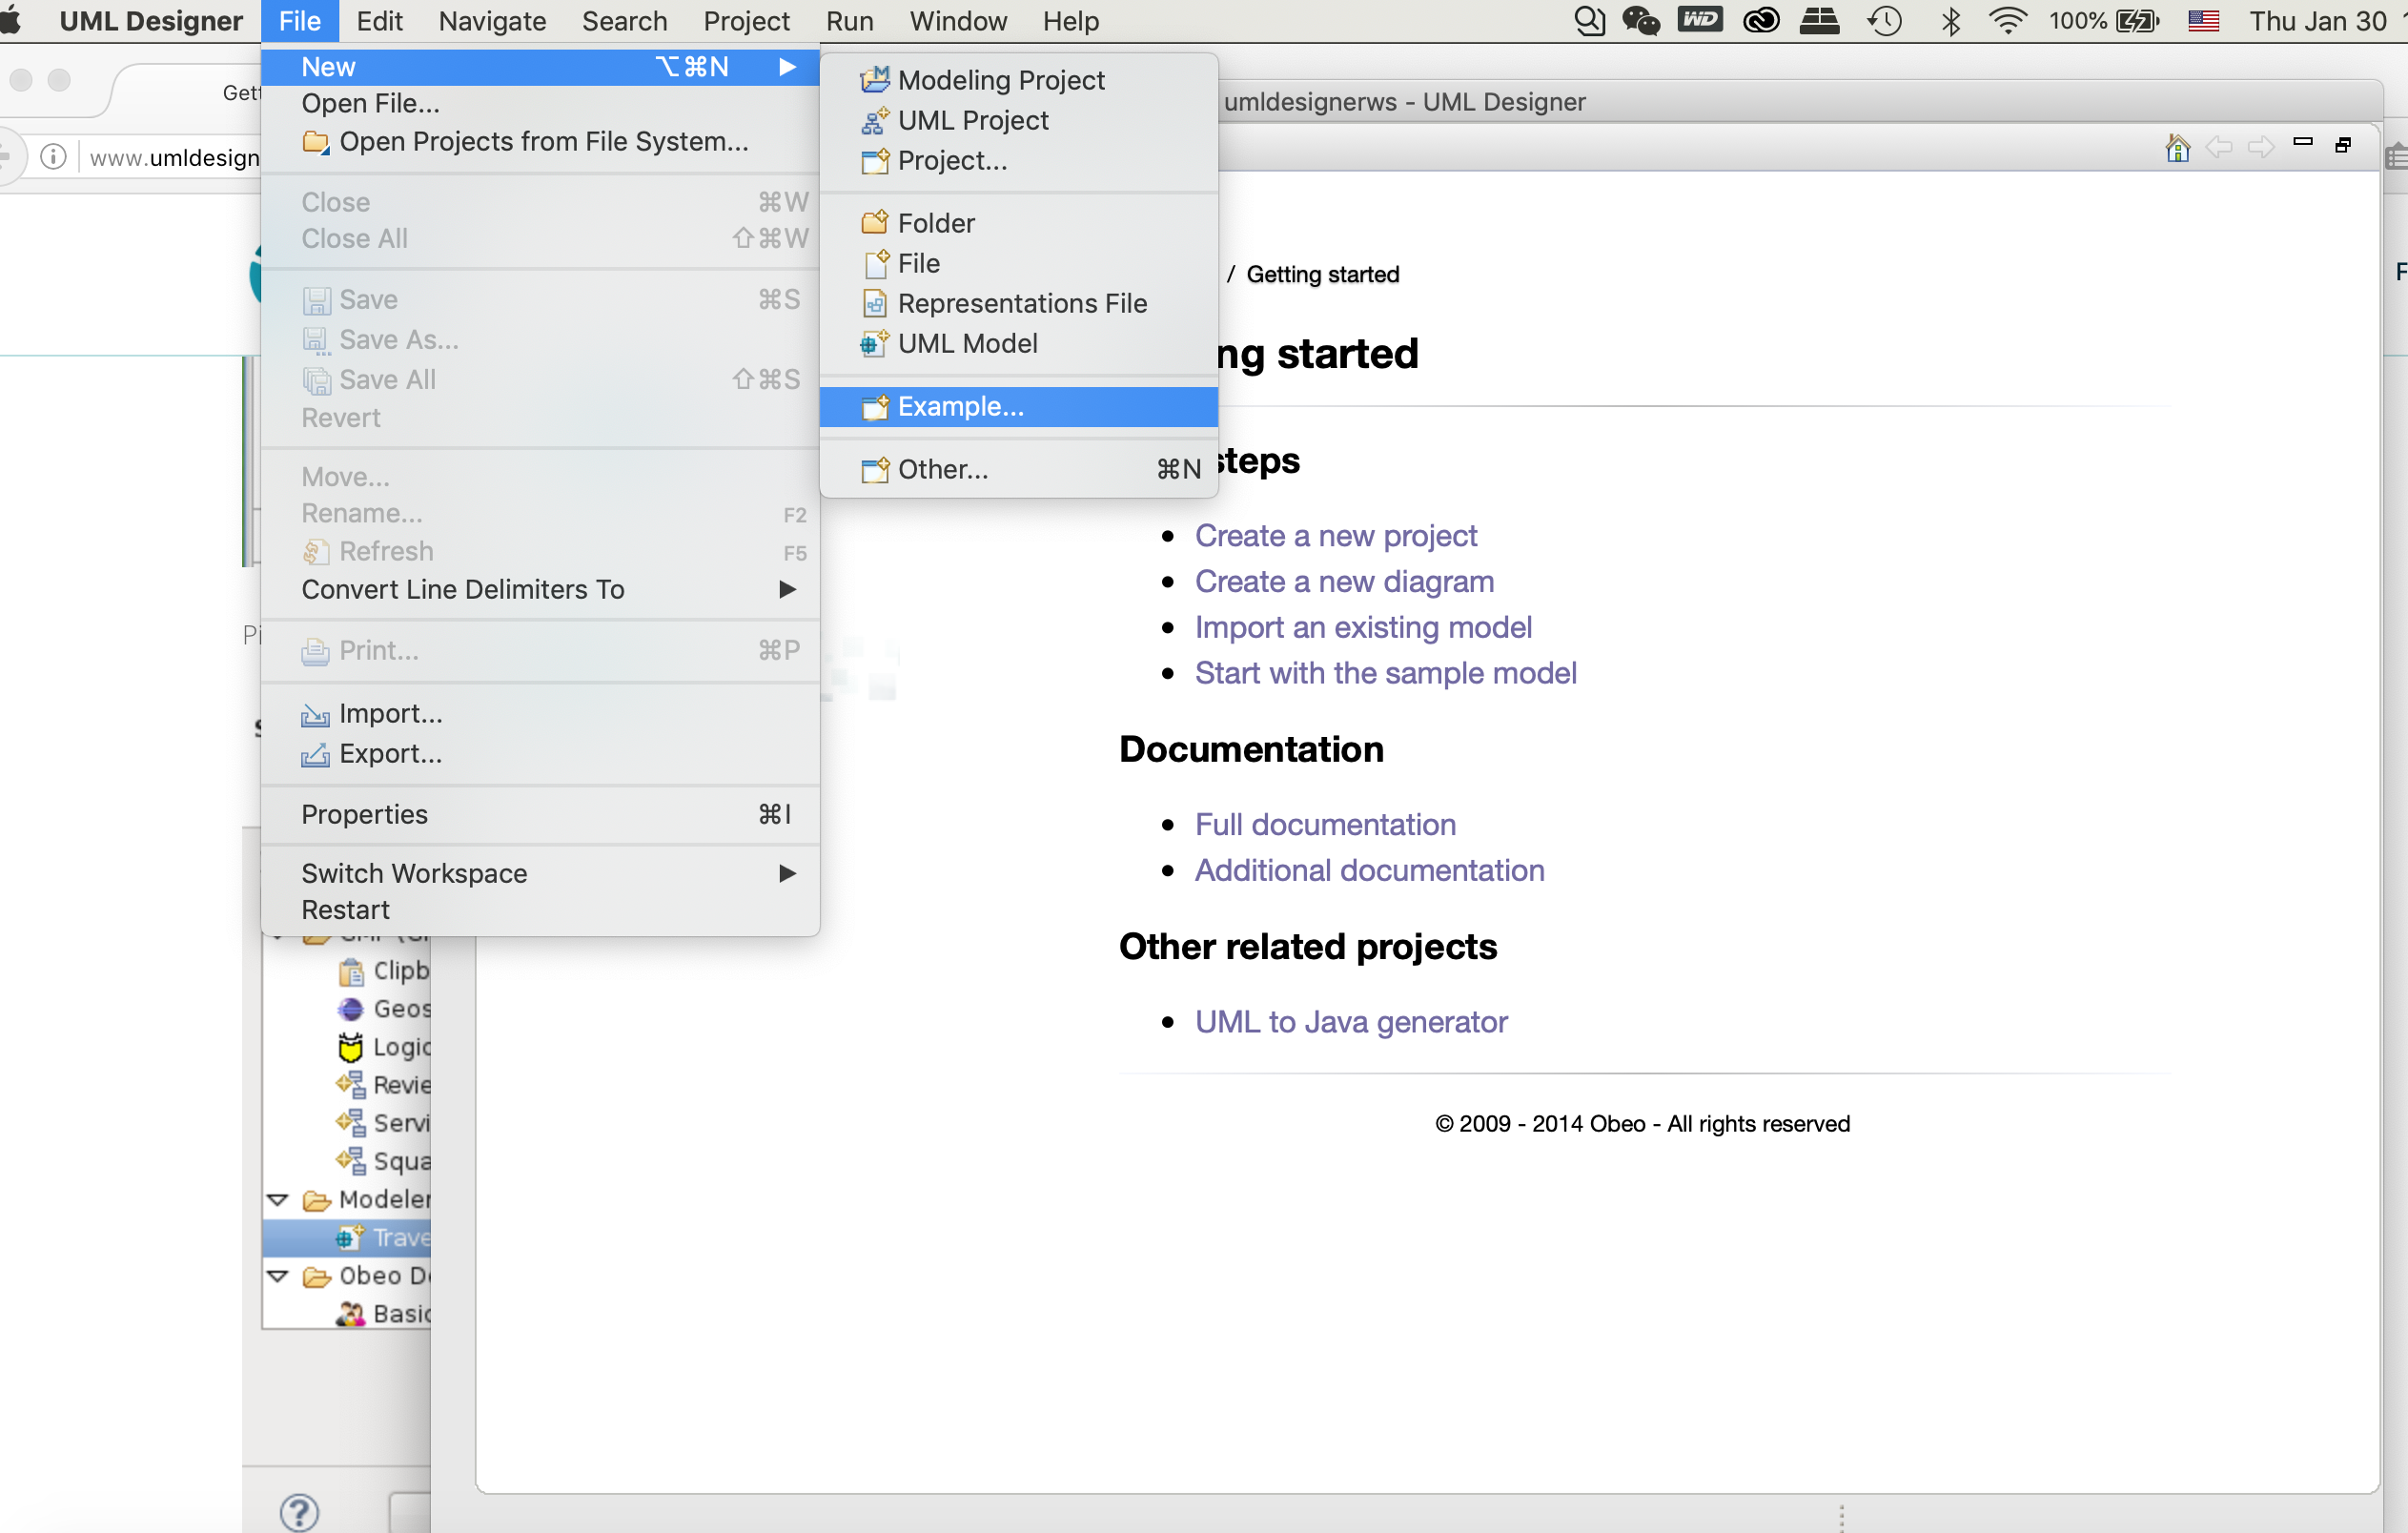
Example(continued..)
How to start a UML diagram?
1.Click on file, find the “New”,
then click on “Example”.

Slide 7
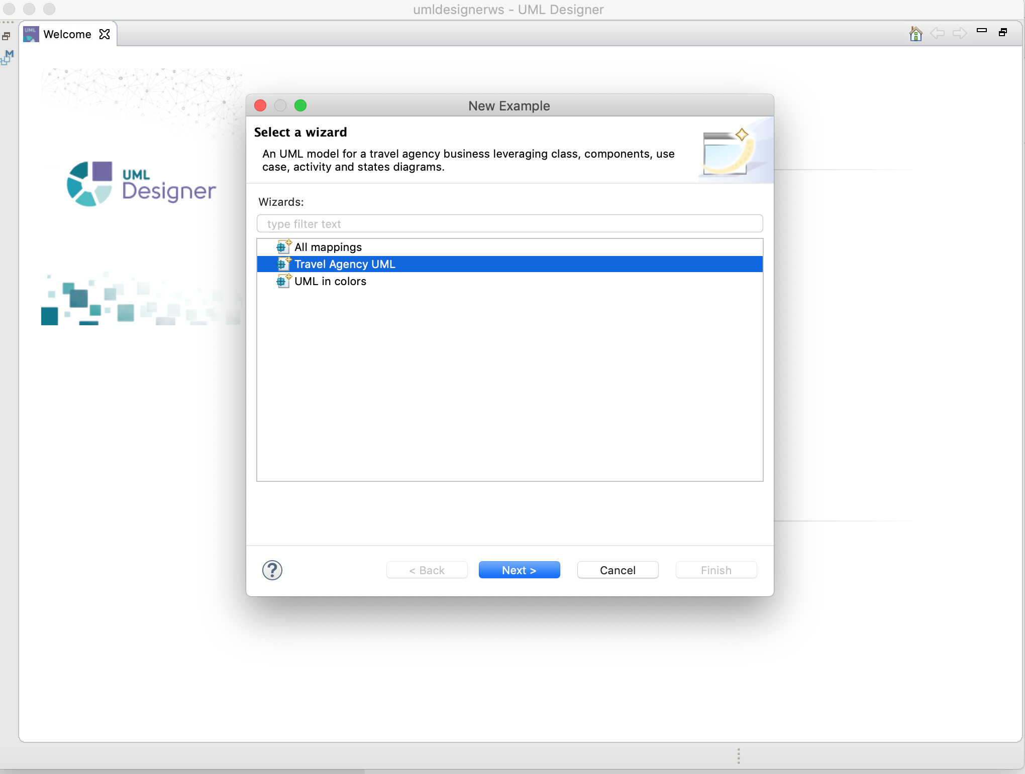
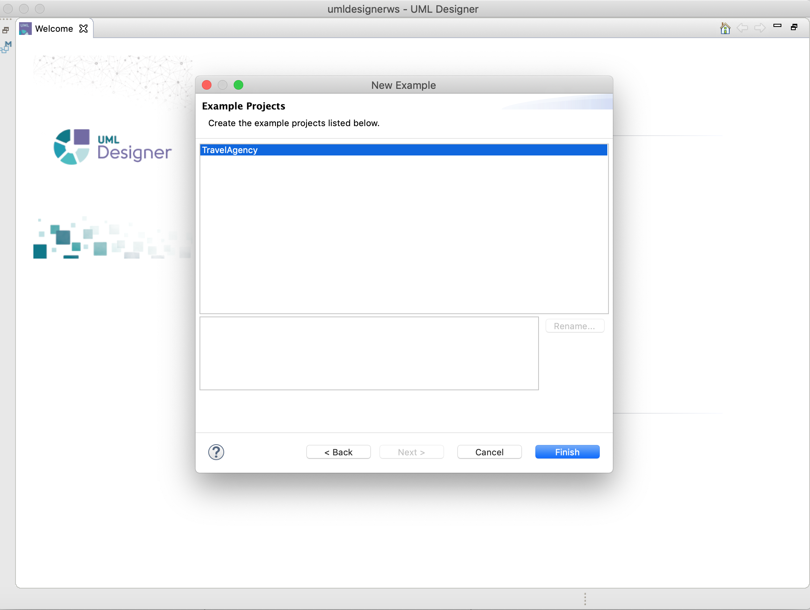
Example(continued..)
2. Find the Travel Agency UML
3.Click on ”Finish” to create the project.

Slide 8
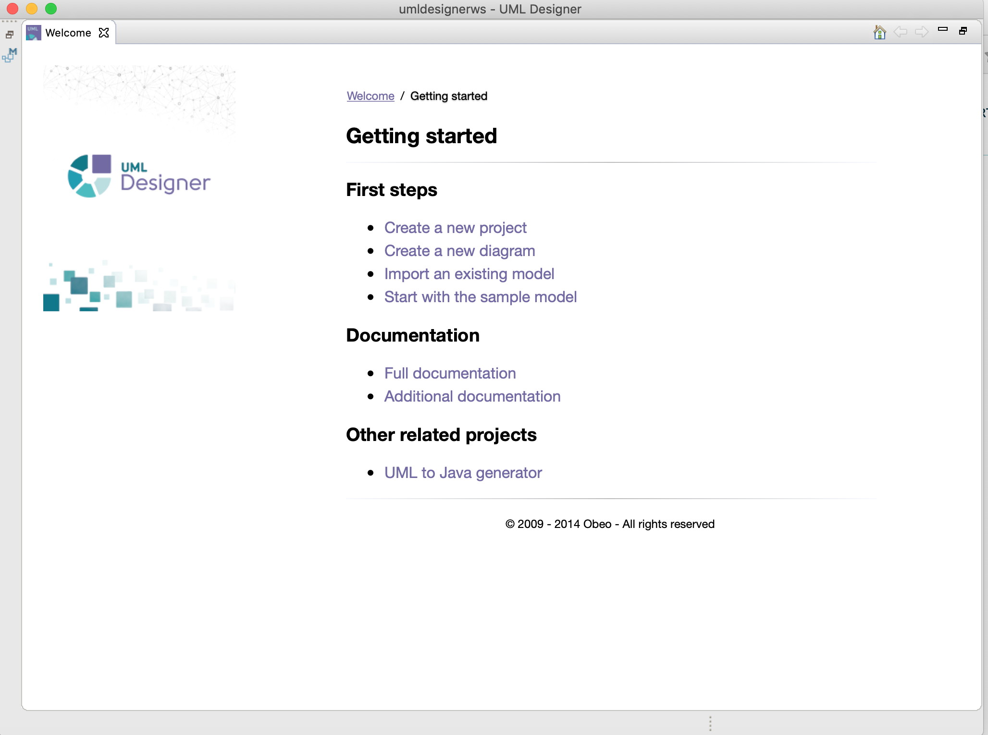
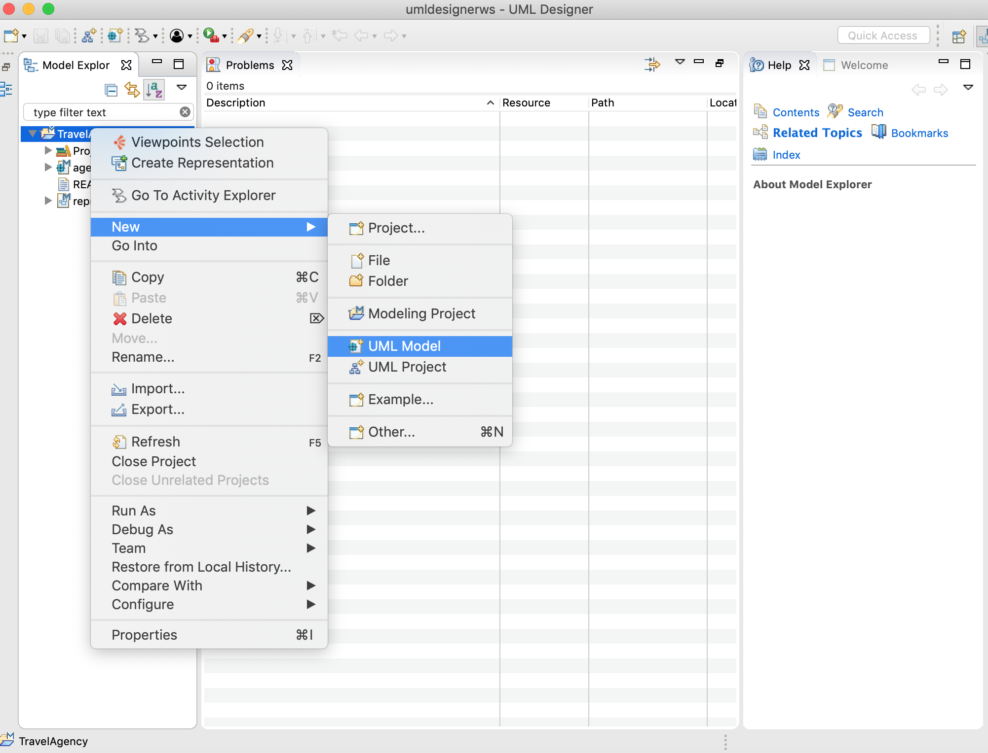
Example(continued..)
4.Go back to the home page.
5.Select ”New” to find the “UML Model”.

Slide 9
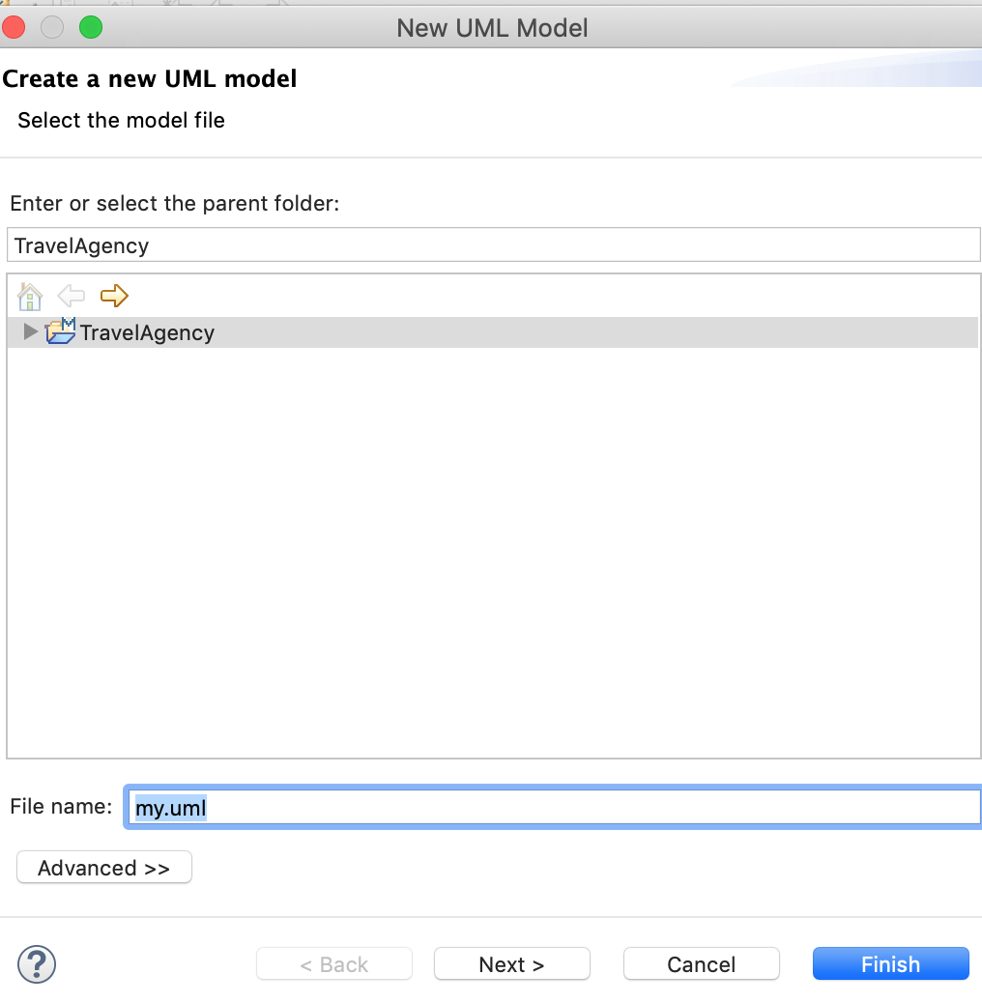
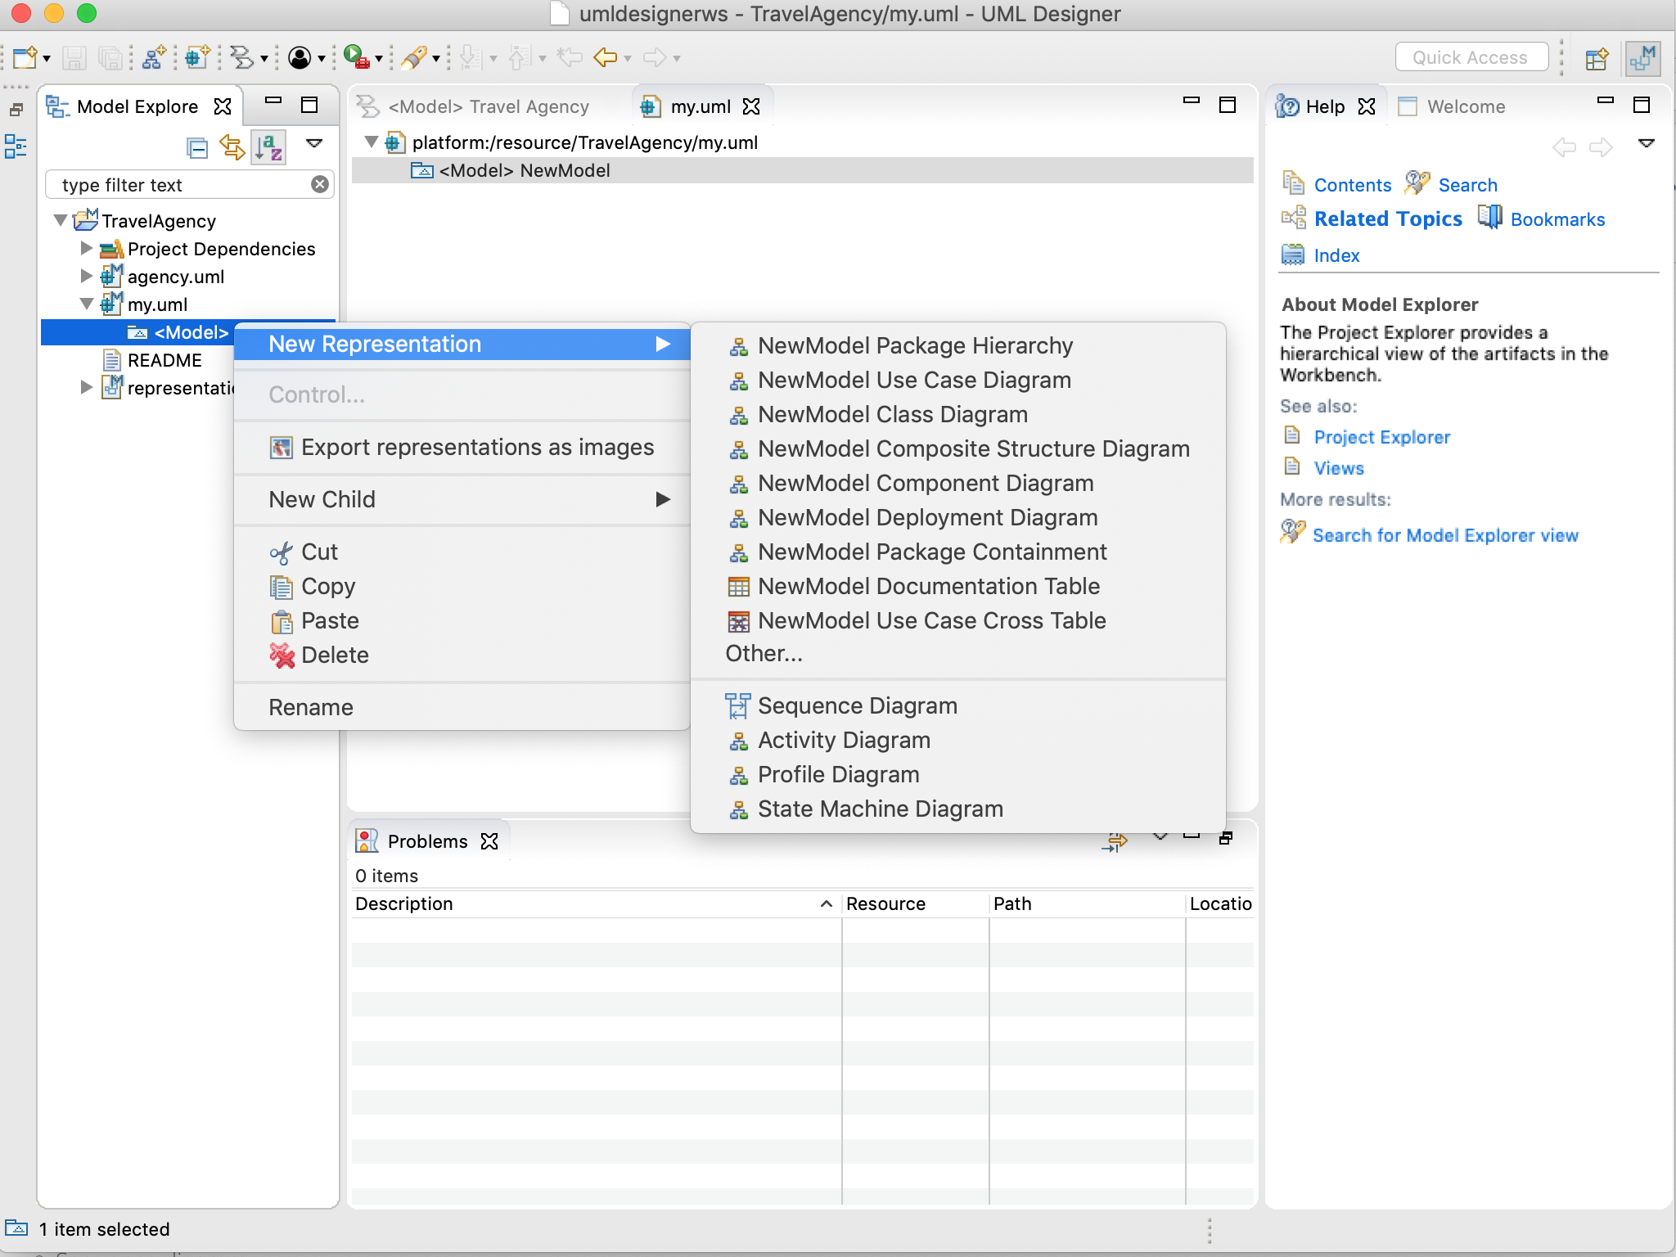
Example(continued..)
6.After created a UML model(named ”my.uml”)
7.Choose a new representation from the list.

Slide 10
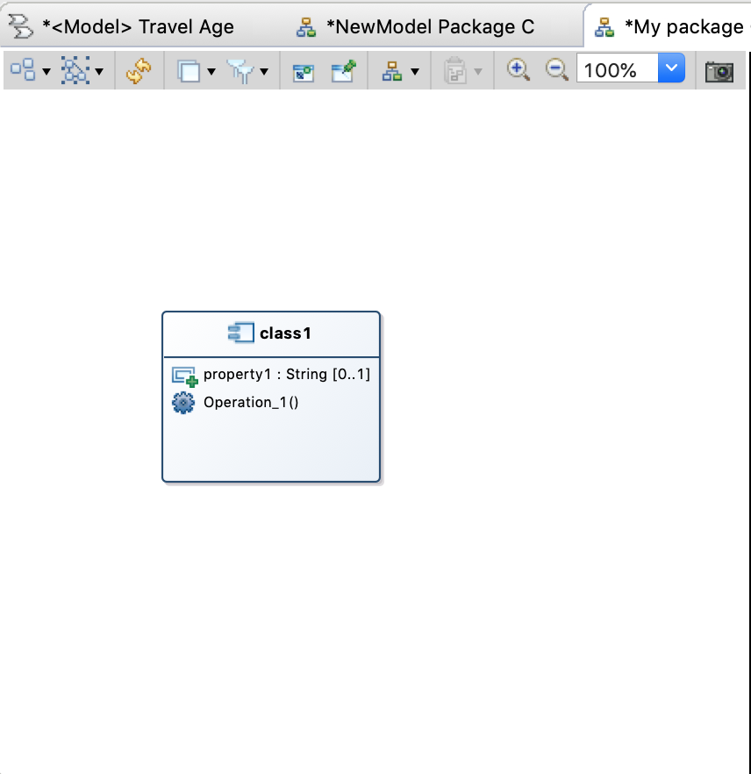
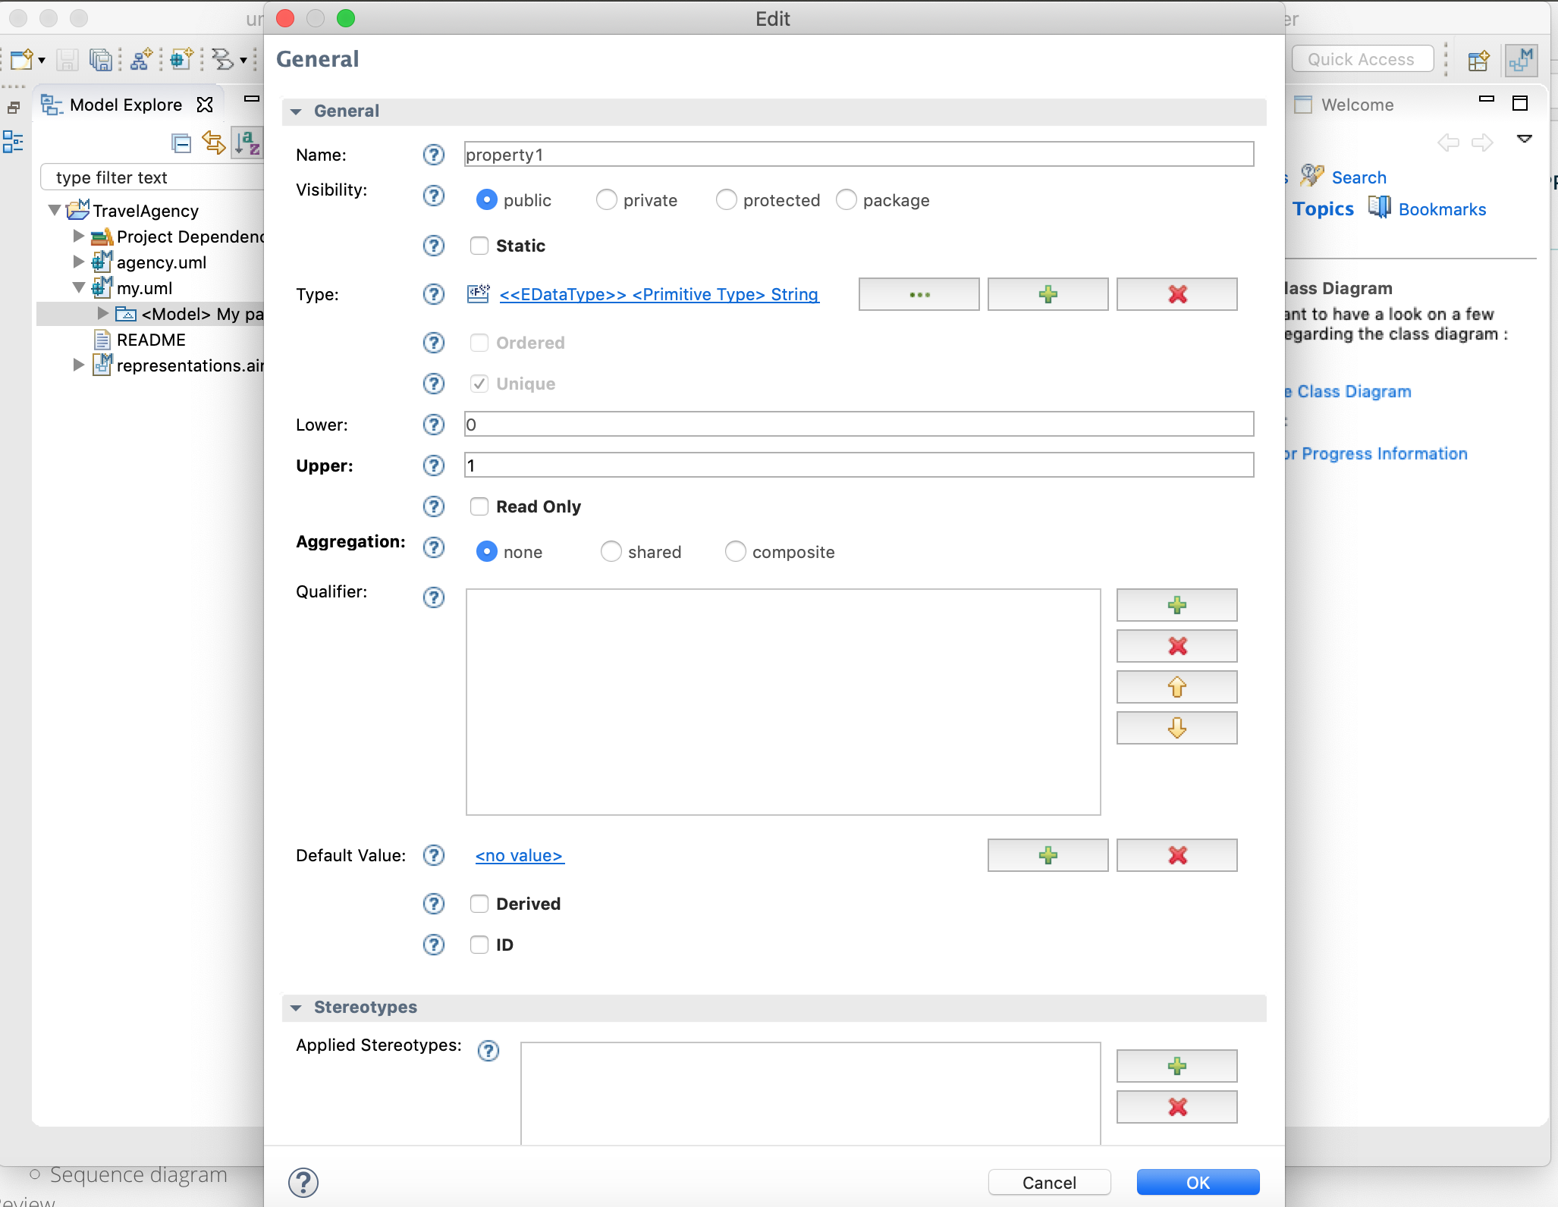
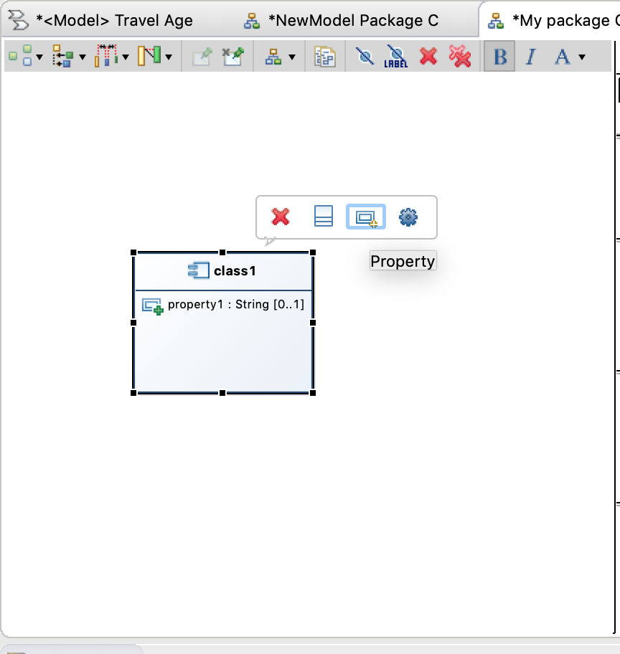
Example(continued..)
8.After create a class, the class could be added on property
or operation, etc..

Slide 11
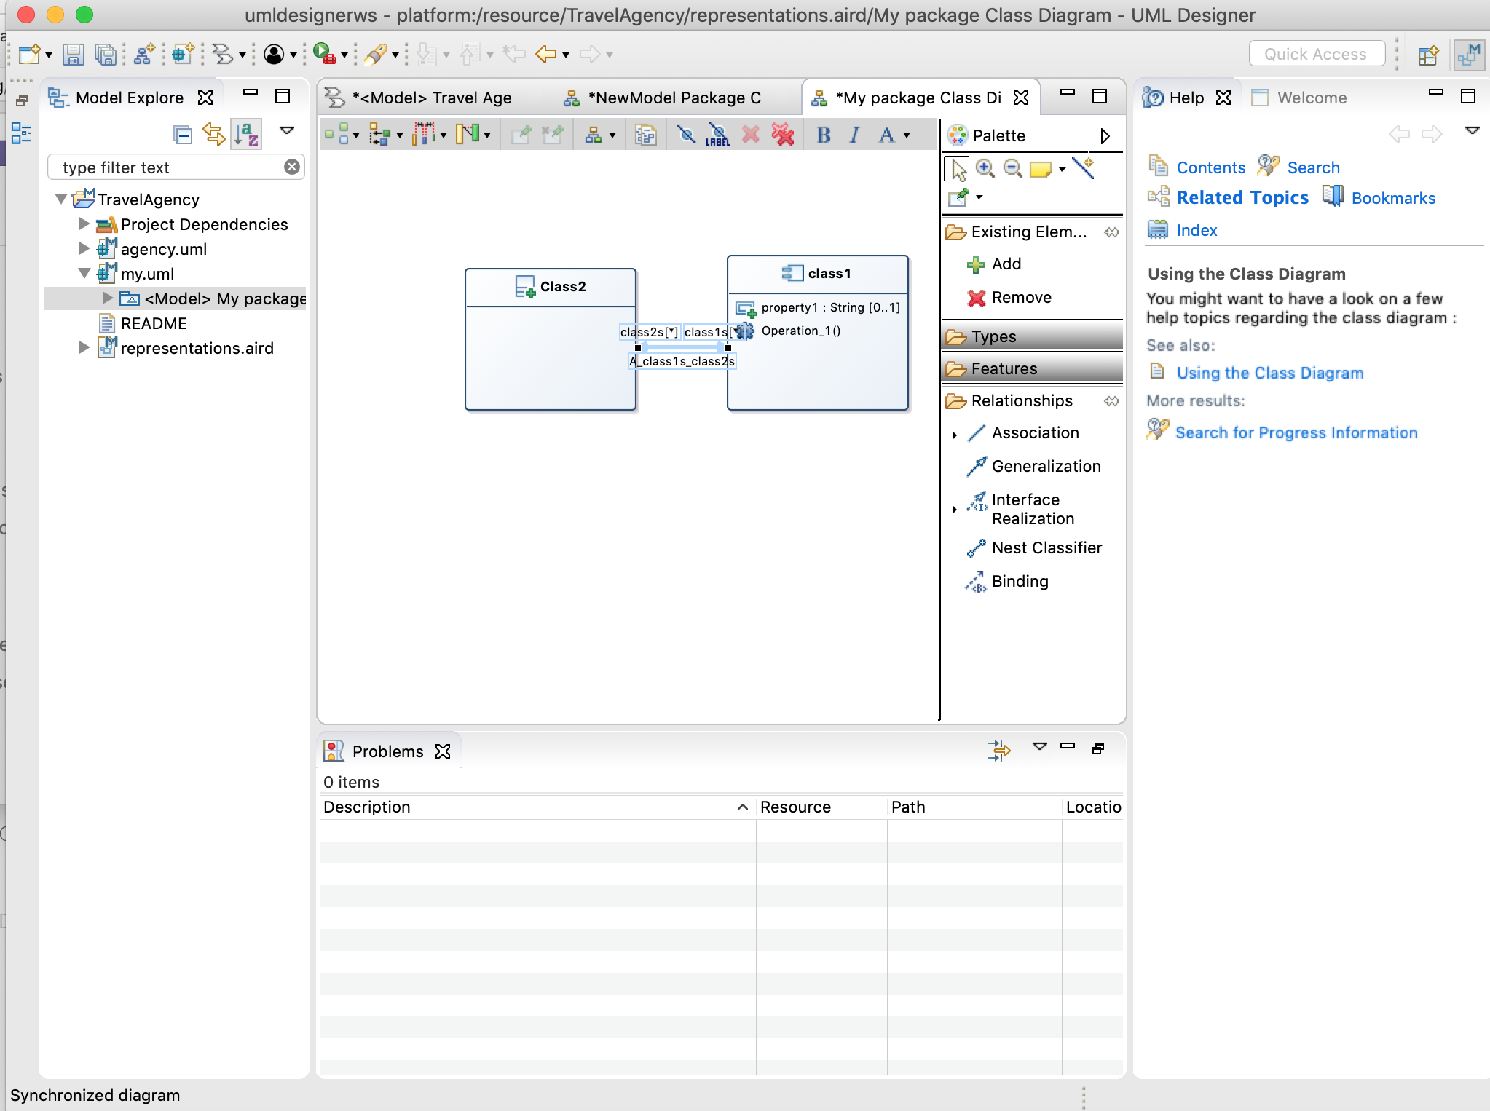
Example(continued..)
9. The most important
thing is there are
relationships between
these diagrams.
In the UML Design,
users could use the
relationship arrows
to let the diagrams
connect to each other.

Slide 12
Example(continued..)
In the pervious slides, it is only explained how to use UML Design. It shows the basic steps that make diagrams and the way to connect the diagrams together.
There are more UML examples such as Activity Diagram, Sequence Diagram, Class Diagram, etc..
Next page…

Slide 13
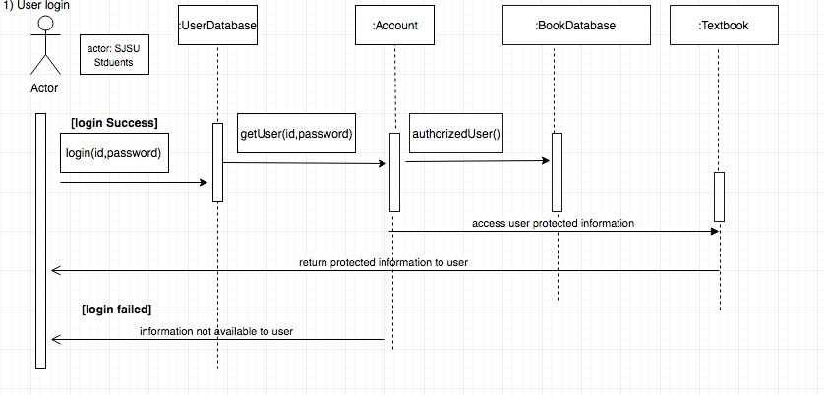
Example(continued..)
Sequence Diagram

Slide 14
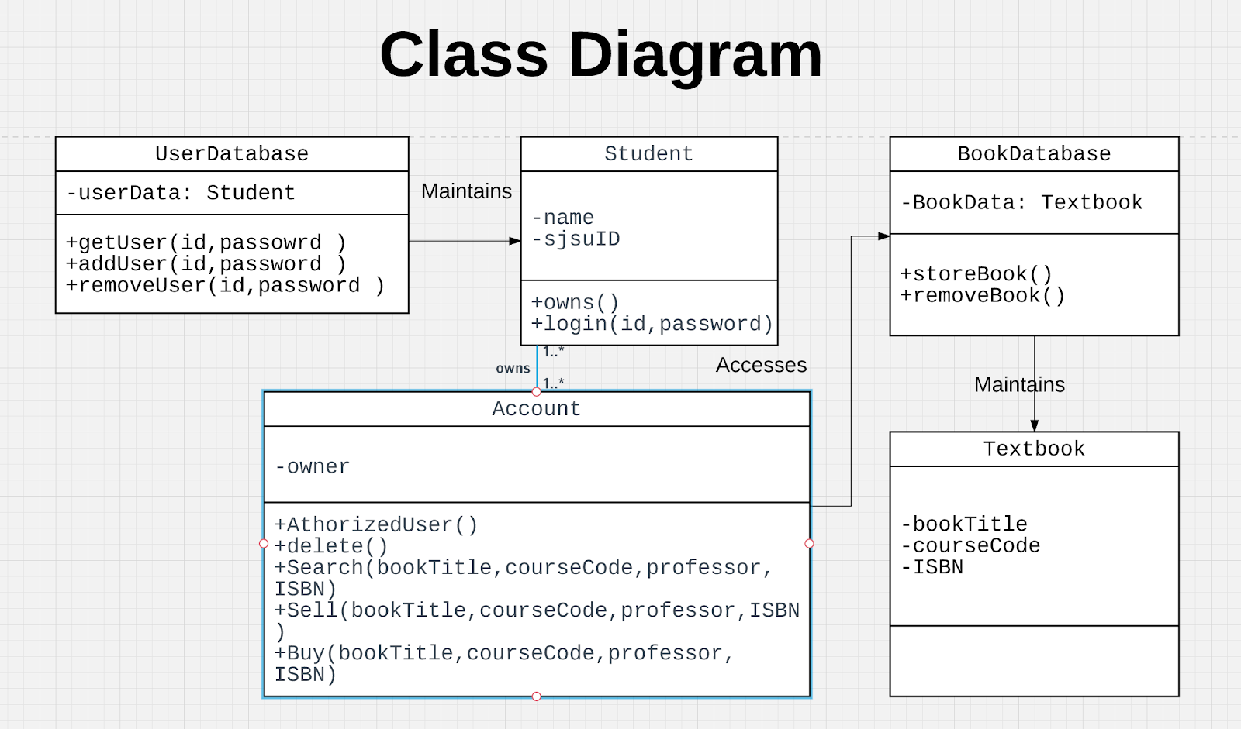
Example(continued..)
Class Diagram

Slide 15
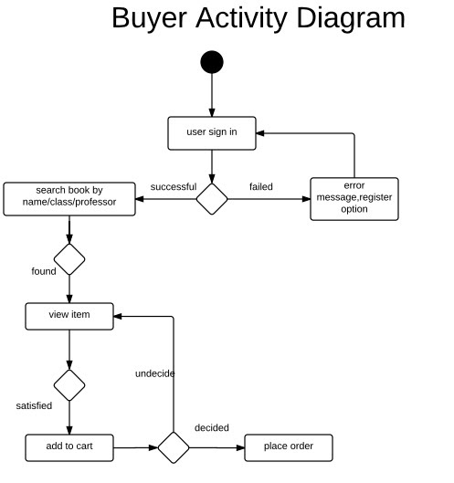
Example(continued..)
Activity Diagram

Slide 16
Class Diagram
A class diagram in the UML is a type of static structure diagram that describes the structure of a system by showing the system’s classes, their attributes, operations (or methods), and the relationships among objects.
The class diagram is the main building block of object-oriented modeling. It is used for general conceptual modeling of the structure of the application, and for detailed modeling translating the models into programming code

Slide 17
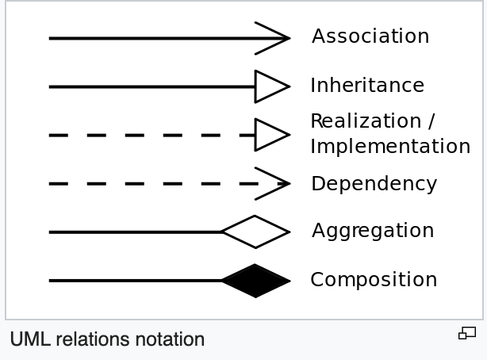
Class Diagram
The relationships in the Class Diagram

Slide 18
Quiz
Let’s do a little quiz..
Please use the UML Designer to draw a diagram about the two types people which include professor and students in the school.
Key words: Person, Professor and students.

Slide 19
References
https://www.youtube.com/watch?v=kbHKcSNlr5I
http://www.umldesigner.org/tutorials/tuto-getting-started.html
https://en.wikipedia.org/wiki/Class_diagram

